Slide 1

Signavio Process Intelligence
Analysing a process by its data
e-Portfolio Joel Bär

Slide 2

Processmodel = How should the work be done
Does the reality correspond to the modell?
Process Mining and Process Intelligence = Analysing based on tracking digital data

Slide 3
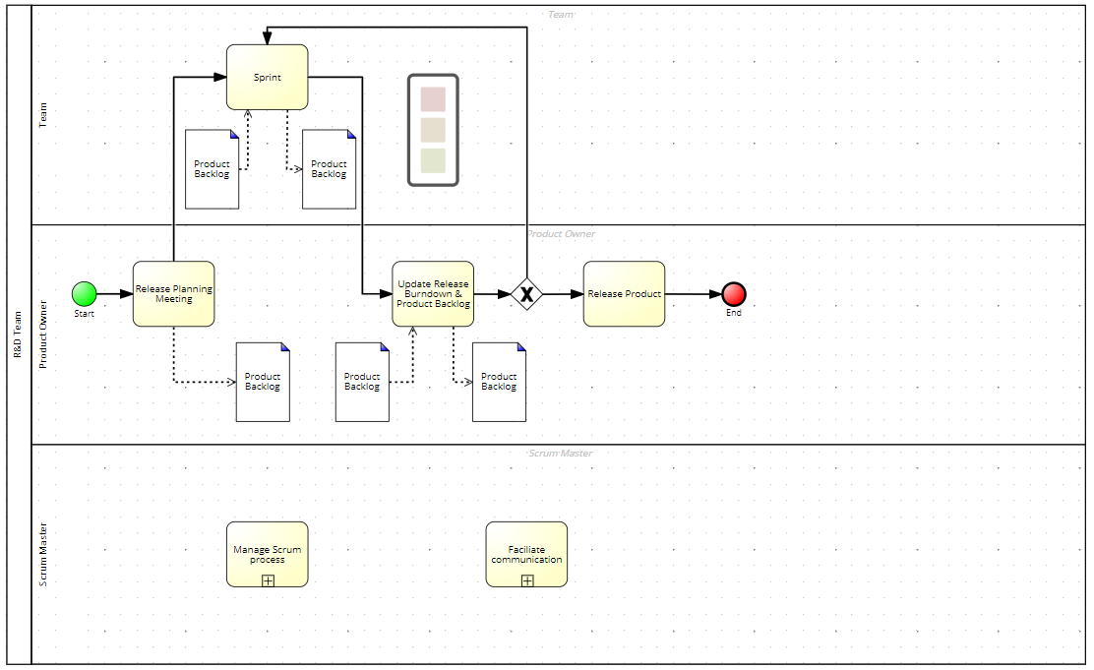

Slide 4


Comparing realitiy with modell
Identify weak spots (bottlenecks)
Checking process conformance

Slide 5
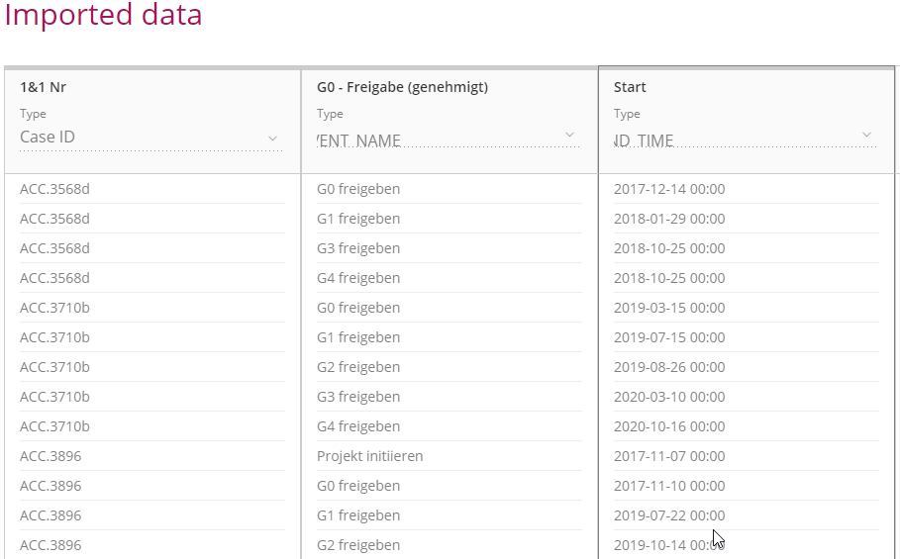
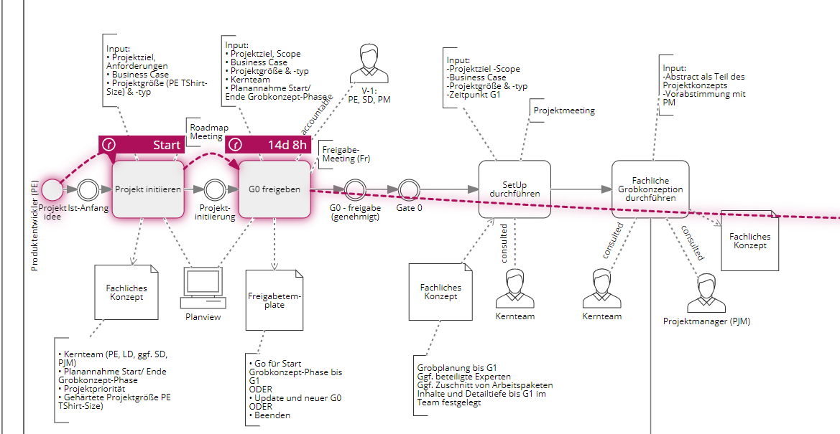
What does PI
Evaluate digital data from log files
Event = CaseID + Activities + Timestamp + Attribute
Notes:
Events müssen auf das Prozessmodell gemapped werden -> angeben, welcher Zeitstempel wo im Modell auftritt
Signavio kann die Daten somit im PI-Tool visuell darstellen
Events sind Spuren eines Falles
-> aus Monitoring, Reports oder Logfiles
CaseID -> Schlüssel

Slide 6
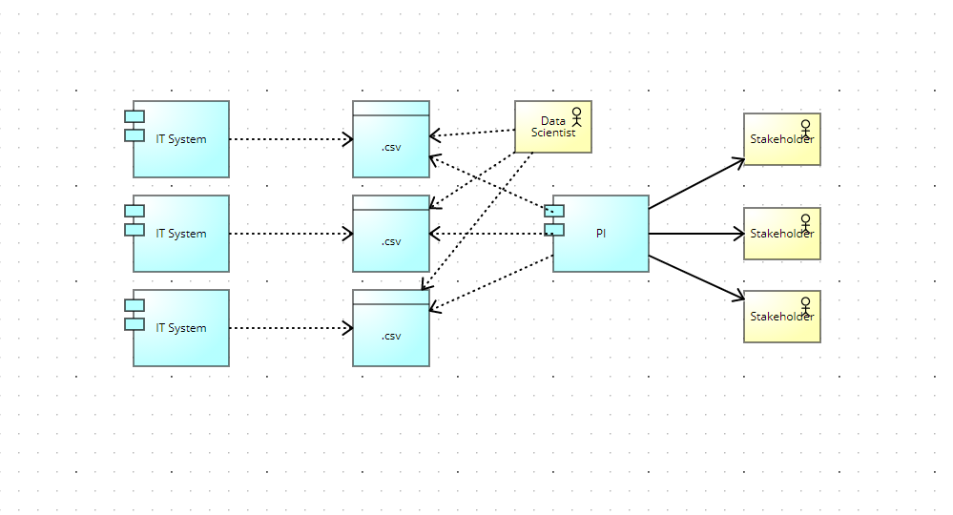
What does PI

Slide 7

Hands-on

Slide 8
Questions?
e-Portfolio Joel Bär

